Slide 1

Online Shopping Cart
(Customer Module)
-By
DonaldJ.K(5617)
Enrollment ID : EBEON0621384678

Slide 2
Spring-Boot
Spring Boot makes it easy to create stand-alone, production-grade Spring based Applications that you can "just run".
We take an opinionated view of the Spring platform and third-party libraries so you can get started with minimum fuss. Most Spring Boot applications need minimal Spring configuration.
Uses:
Spring Boot helps developers create applications that just run. Specifically, it lets you create standalone applications that run on their own, without relying on an external web server, by embedding a web server such as Tomcat into your app during the initialization process

Slide 3
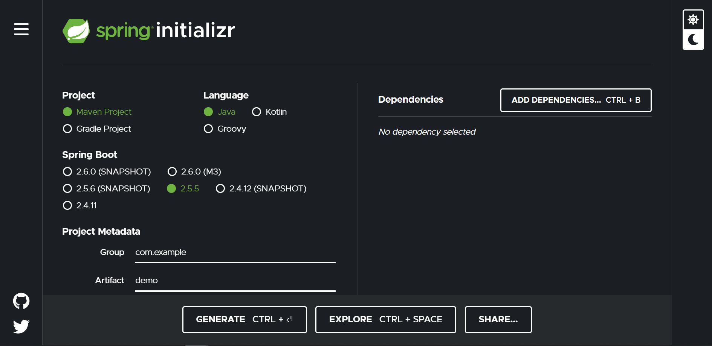
Spring-Boot Creation:
To Create a Spring-Boot project the system requirements are java ,maven and spring framework.
To create a Spring Boot Project in a simple way go to Spring-Initializer https://start.spring.io/ in that Select the or add the necessary dependencies and give the appropriate Group , Name, Artifact Id etc.
Then click on Generate and it gives us a jar file which needs to be extracted and the extracted file should be imported into our workspace to work with it.

Slide 4
Introduction:
Our Online Shopping Cart is developed using Spring-Boot with multiple modules in it.
Online Shopping Cart is used to buy Products online without the need of going to shop and buying it in person.
An Online Shopping consists of multiple number of Dealers and Buyers.
Products can be viewed by the users and if interested they can buy and pay via Online payment or cash on delivery.
In our Online Shopping Cart we have some modules to work with,
They are,
Login and Registration,
Admin,
User,
Dealer,
Cart,
Payment.

Slide 5
Module:
User Module:
In this module we are going to surf through the working process of User.
The main activities of users is to browse through the products and buying it.
In-order for the user to do those activities it needs some relationship called as Mapping with some other Modules.
So the modules which the User Module needs are User Registration and Login Info,
Products Info(Dealer Module), access to add products to Cart.

Slide 6
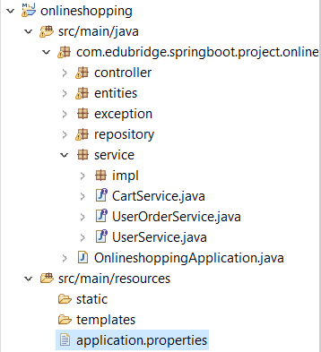
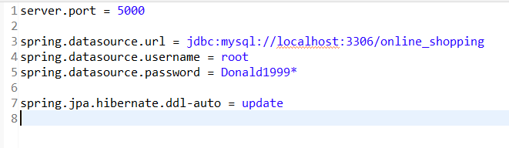
Project Structure:
Our Project Structure consists of Controller, Entities, Repository, Service, Service Implementation.
Each Structure is used for getting info, user case activities etc.
The Main Class is Autogenerated by Spring-Boot, so its not necessary to create a Main Class.
Application Properties must be used to connect with MySQL,
and to give other properties.

Slide 7
Annotations:
In Spring-Boot project many annotations will be used those are from spring packages.
Annotations uses in this project are,
@Entity
@Table
@Id
@Column
@GeneratedValue
@OnetoOne, OnetoMany, ManytoOne, ManytoMany
@JoinColumn, JoinTable
@Repository
@Service
@AutoWired
@RestController
@PostMapping, GetMapping, DeleteMapping, etc.

Slide 8
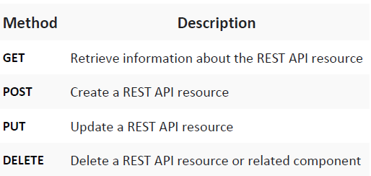
METHODS:
Links Used :
"user/users“ – To get all users.
"/user/{id}“ – To get user by Id.
"/user/add“ – To save a new user.
"/user/{id}“ – To update user info.
"/user/{id}“ – To delete user by Id.

Slide 9
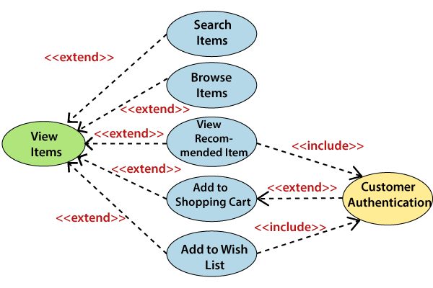
UseCase:

Slide 10
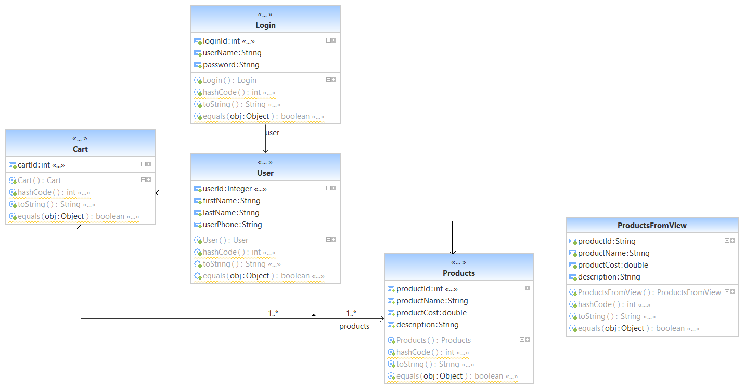
UML Diagram:

Slide 11

THANK YOU
Thank You
GitHub Repo :https://github.com/Donald189/online-Shopping.git

